Slide 1
Week 10: Image Compression
Hazal Mogultay and Fatoş Yarman Vural

Slide 2
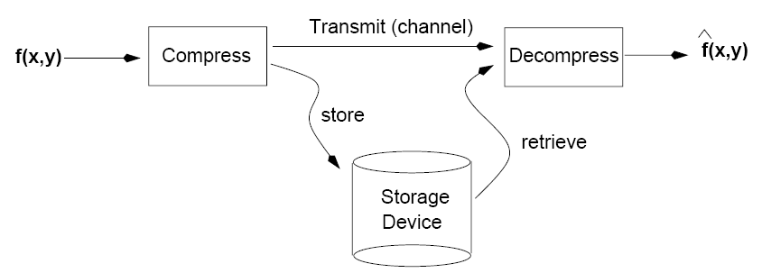
Image Compression
Goal: Reduce the amount of data while preserving as much information as possible!

Slide 3
Hierarchy of Abstraction for Information Representation
Code: A set of symbols
Codeword: Sequence of symbols
Data: Collection of codewords to represent information
Information: Meaning of data
Information
Data
Codewords
Codes

Slide 4
Although the concept of data and information are not the same, they are strongly related to each other.
Data is defined as the collection of the codewords to represent the body of information.
Data is the means by which information is conveyed.
Fact: The amount of data to represent the same amount of information changes, depending on the predefined codes and codewords.

Slide 5
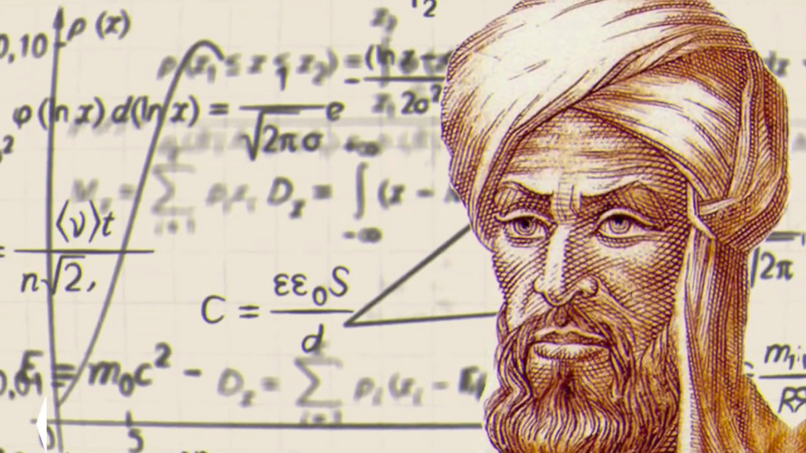
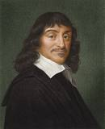
Ex: Two types of data convey same information
Al-Khwarizmi (X Century): “Find a number such that, when you add its square to twice the number itself, the result is 34. “
Codes: Letters,
Codewords: Arabic words
Data: Sentence
Information: Context of the sentence
Rene Descartes (XVII Century) : x²+2x=34.
Codes: Alphanumeric symbols
Codewords: Expressions
Data: Equation
Information: Context of equation

Slide 6
The key question in image compression:
What is the minimum amount of data that is sufficient to describe completely an image without loss of information?
How do we measure the information content of an image?

Slide 7
Information- Inform-Informatio- ”To give form to the mind”

Slide 8
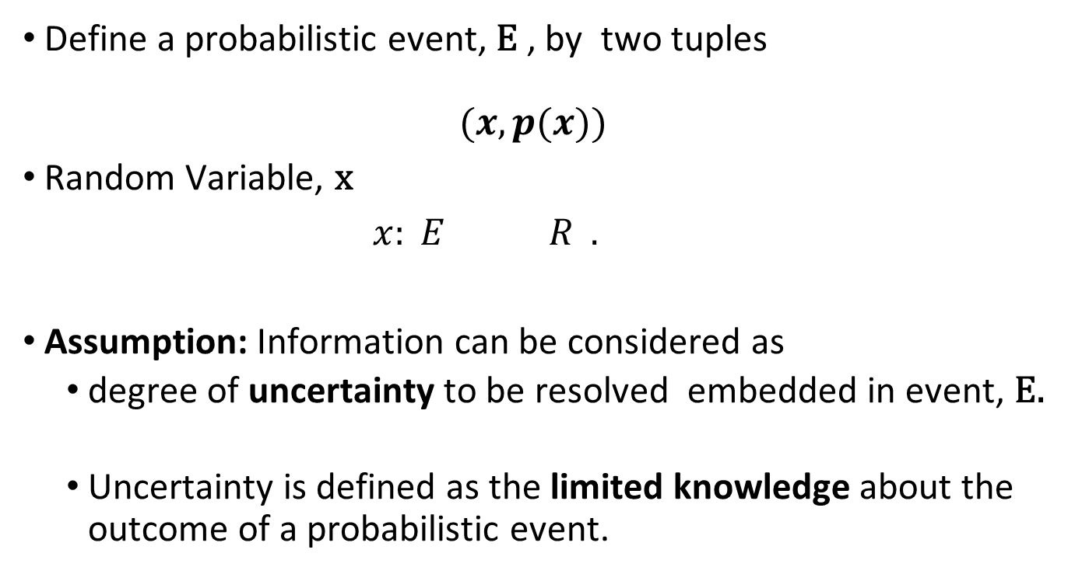
Information Theory (Shannon, 1948)
Define a probabilistic event, E , by two tuples
$$(x, p(x))$$
Random Variable, x
$x: E R .$
Assumption: Information can be considered as
degree of uncertainty to be resolved embedded in event, E.
Uncertainty is defined as the limited knowledge about the outcome of a probabilistic event.

Slide 9

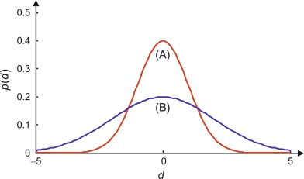

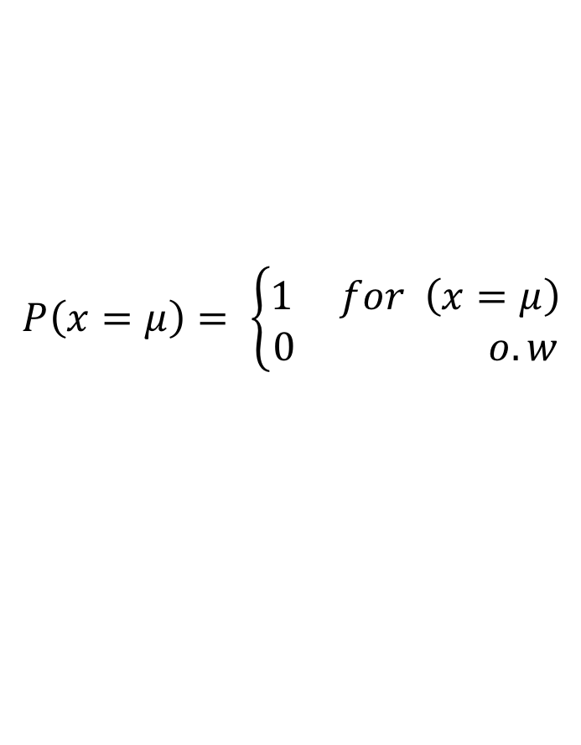
Probability of sun rising from the east:

Slide 10
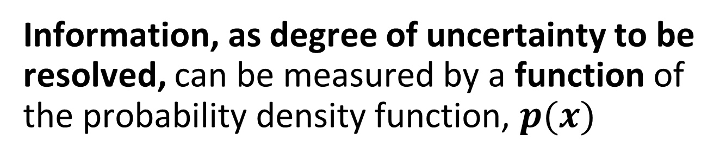

Information, as degree of uncertainty to be resolved, can be measured by a function of the probability density function, $p(x)$
Find a function of $p(x)$, such that it is
intuitively correct,
a positive quantity
a monotonically nondecreasing function of $p(x)$

Slide 11
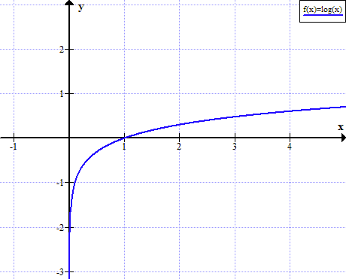
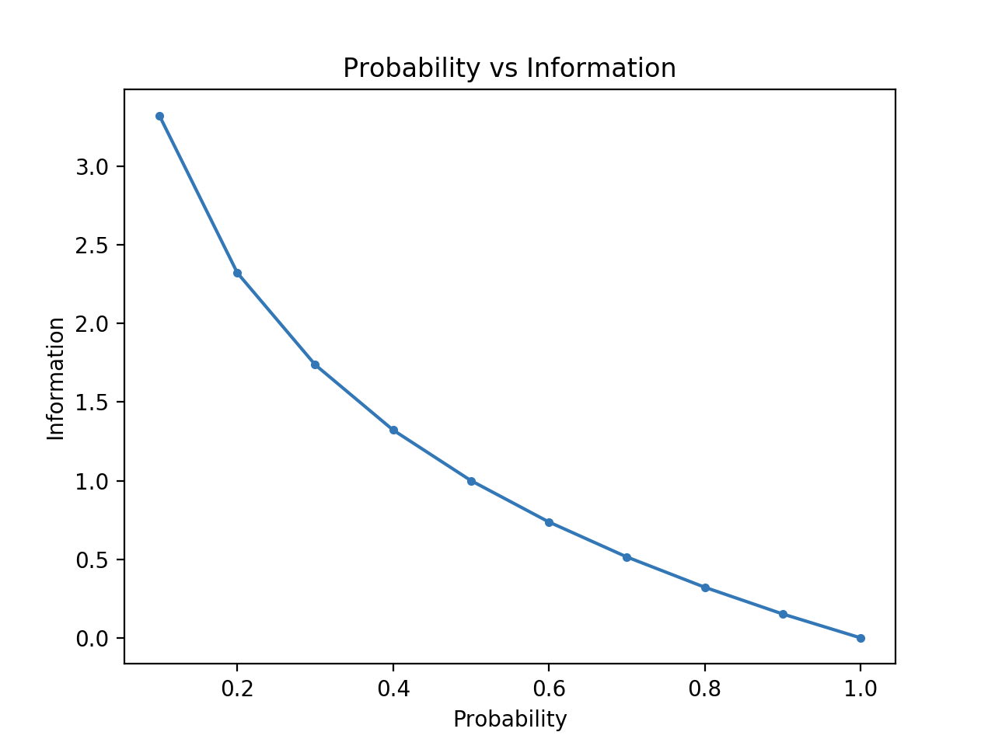
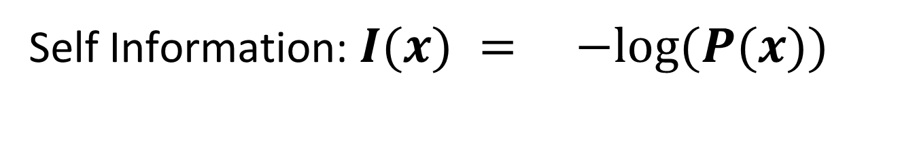
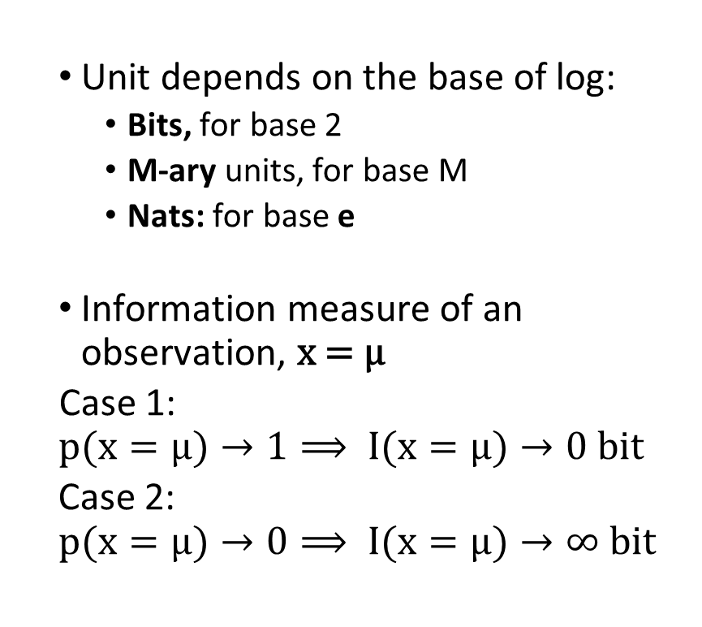
Self Information: $I(x) = −log⁡(P(x))$
Unit depends on the base of log:
Bits, for base 2
M-ary units, for base M
Nats: for base e
Information measure of an observation, x = μ
Case 1:
$$p(x=μ)→1⟹ I(x=μ)→0 bit$$
Case 2:
$$p(x=μ)→0⟹ I(x=μ)→∞ bit$$

Slide 12
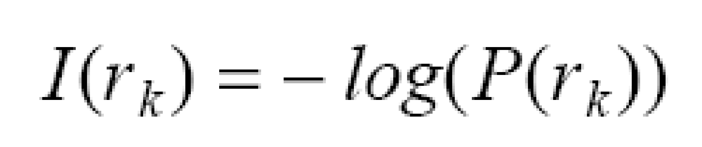
How much information does a pixel value contain?
Suppose that gray level values are generated by a random process, then r_{k} contains:
The information content of a pixel is inversely proportional to its relative frequency of occurrence.
bits

Slide 13
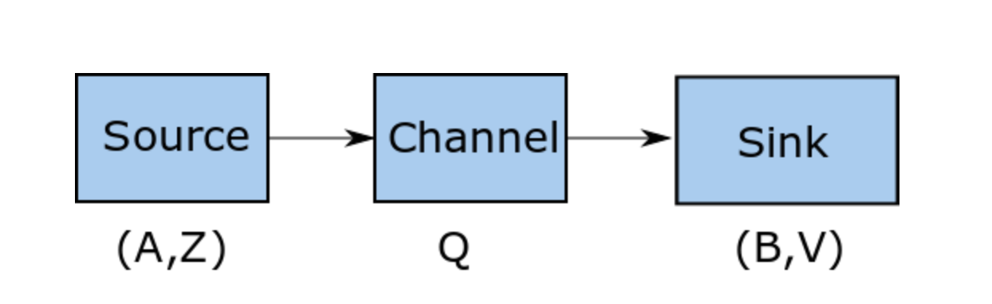
Information Channel
source, which generates information,
channel where the information is conveyed or stored and
sink, where the information is received and consumed,

Slide 14
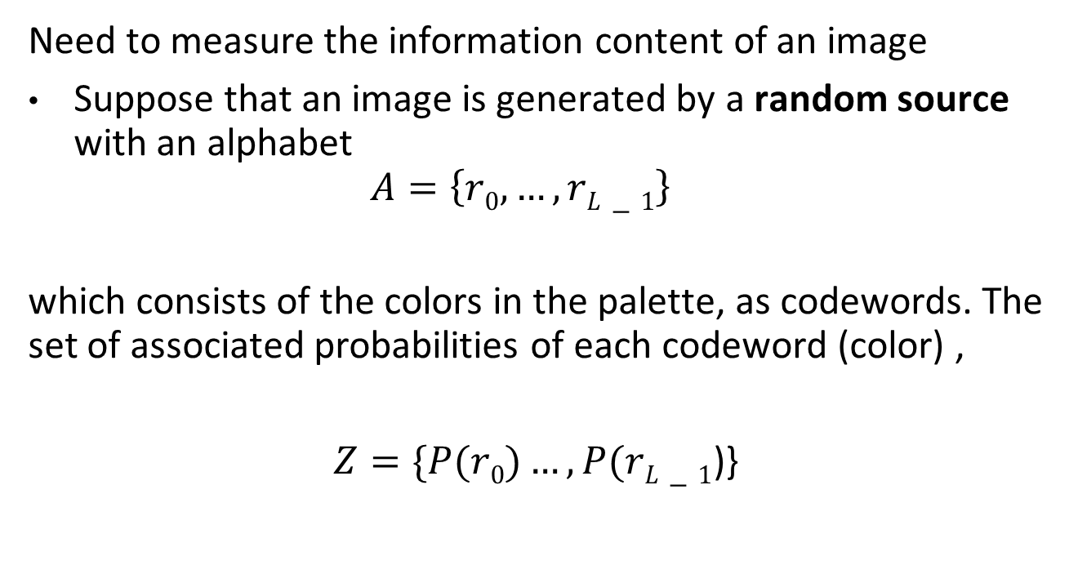
What is the minimum space for storing an image with the same amount of information?
Need to measure the information content of an image
Suppose that an image is generated by a random source with an alphabet
$$A=\left\{r0​,…,rL−1​\right\}$$
which consists of the colors in the palette, as codewords. The set of associated probabilities of each codeword (color) ,
$Z=\{P(r0)…,P(rL−1$)}

Slide 15
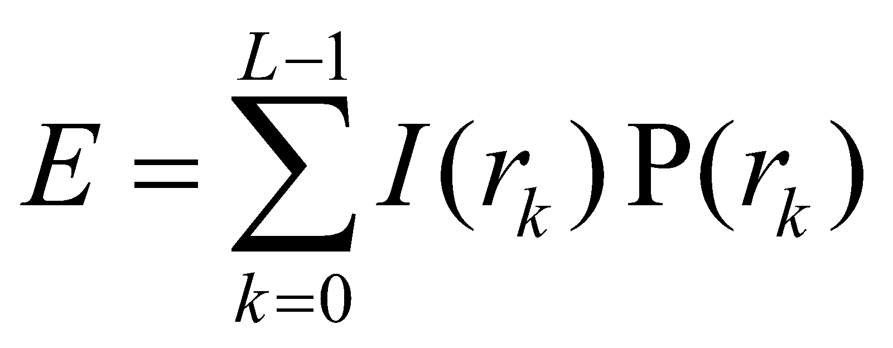
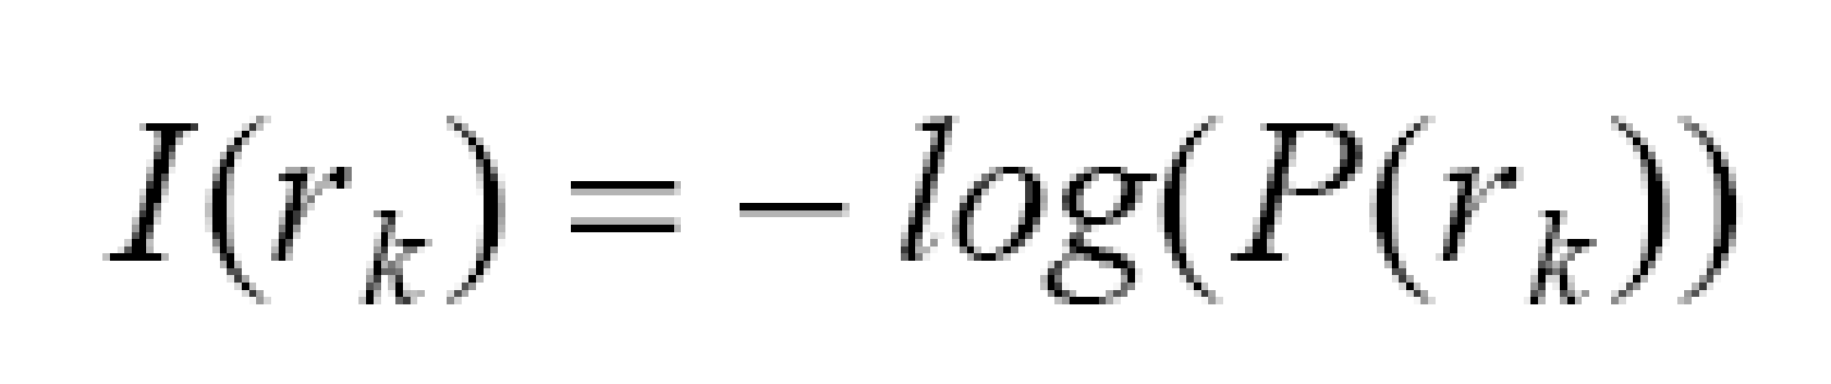
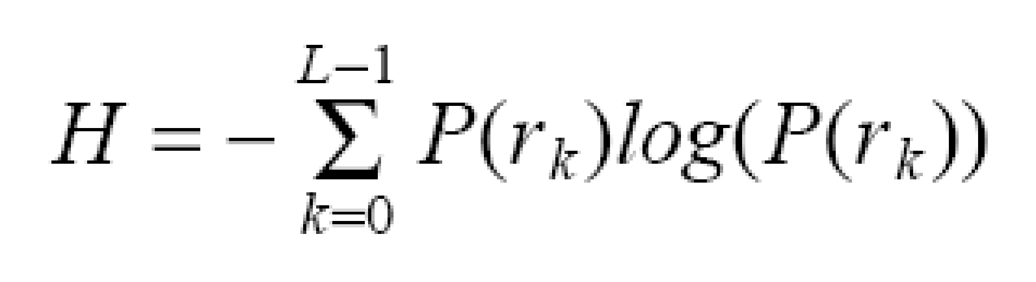
Entropy: Average Information
Average information content of an image:
H
using
units/pixel
(e.g., bits/pixel)

Slide 16
Exercise: Consider an image with a flat histogram of L=4 colors
What is the prob of occurrence for each color?
How many bits do we need to represent self information of a codeword for each color?
What is the entropy of generating this image?

Slide 17
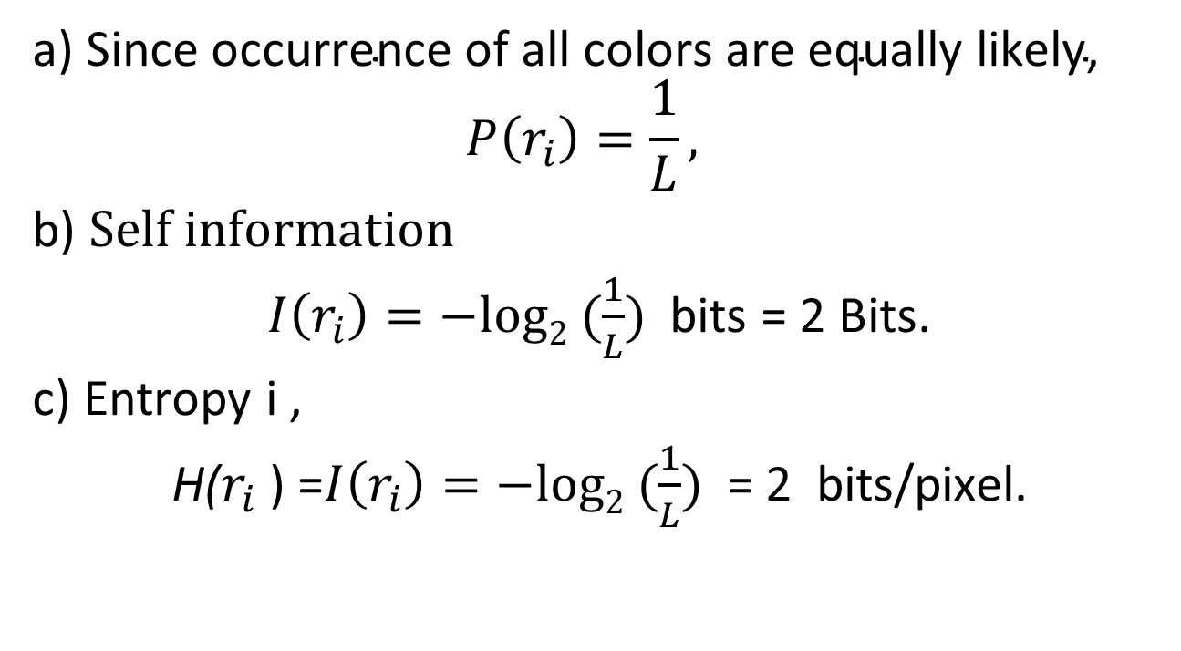
Answer:
a) $\text{Since} \text{occurrence} \text{of} \text{all} \text{colors} \text{are} \text{equally} \text{likely}\text{, }$
$$P\left(r_{i}\right)=\frac{1}{L},$$
b) $Self information$
$I\left(r_{i}​\right)=−log2​ (\frac{1}{L})$bits = 2 Bits.
c) Entropy i ,
H($r_{i}$) =$I\left(r_{i}​\right)=−log2​ (\frac{1}{L})$ = 2 bits/pixel.

Slide 18
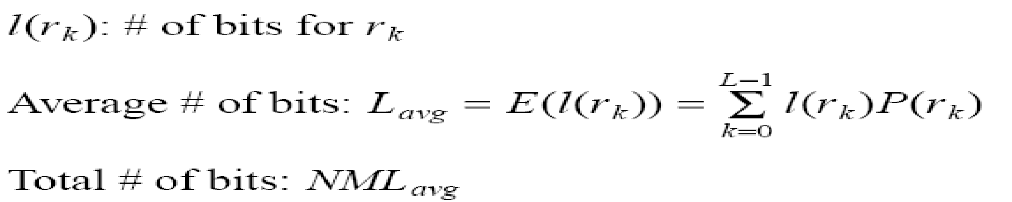
Measuring average amount of information and average amount of data
Average amount of information per pixel, Entropy
bit/pixel
Average amount of data, allocated for L colors
bit/pixel
where , l(r_{k}) is the codelength of color , r_{k}

Slide 19
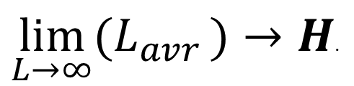

Coding Theorem: Relationship between the data and information The lower bound for the average number of codelengths in a compressed image approaches to entropy, as we increase the number of colors, L.
$$L_{avr}≥H$$
$\lim_{L→∞}{{(L}_{avr}}​)→H$.

Slide 20

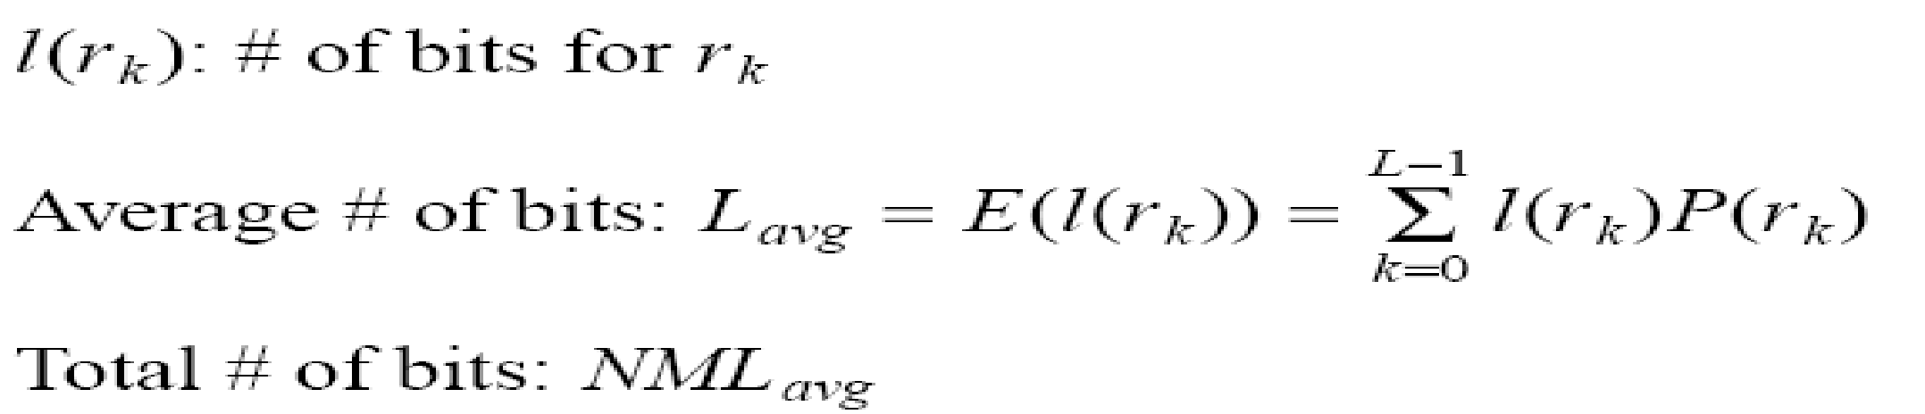
Redundancy:
Difference between average data and average Information
where
Note: if L_{avg}= H, then R=0 (no redundancy)

Slide 21
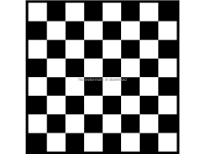
Ex: Consider a binary image of checkerboard
Find the entropy of this image.

Slide 22
Answer:
P(r_{k} =0) =
P(r_{k} =1) =
Self information:
I(r0) =I(r1) =-log (pr0) =1 bit
Entropy:
If we allocate l(r_{k}) =4 bits to code this image, then, L_{av} = 4 Bits/pixel
Redundancy
= 0.5+0.5= 1 bit/pixel

Slide 23
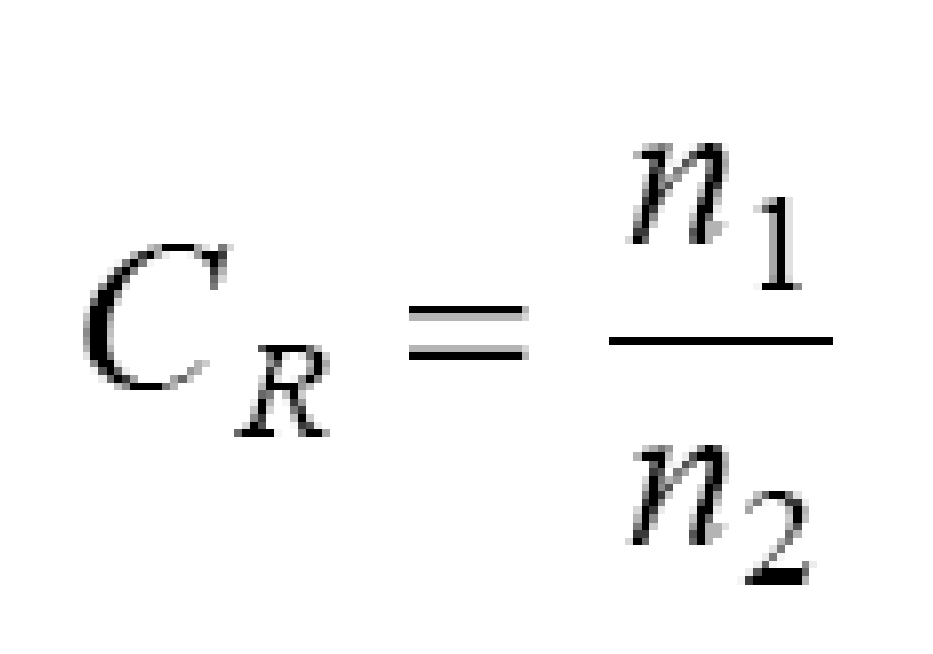
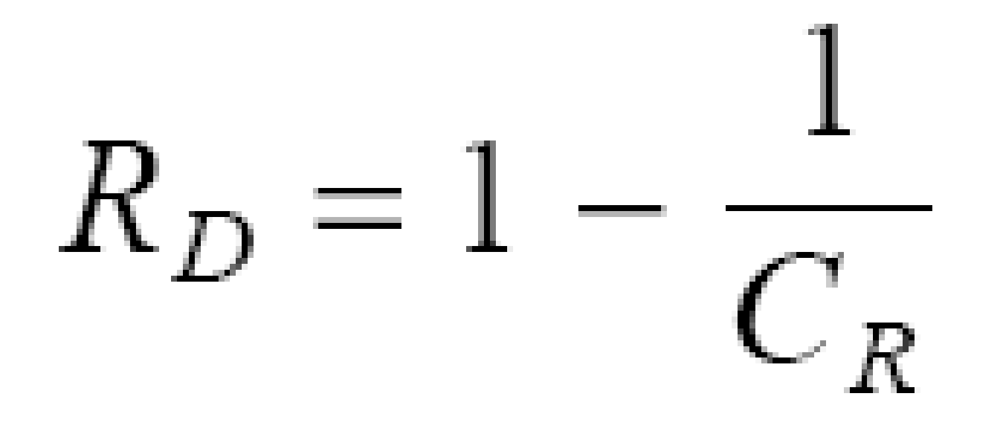
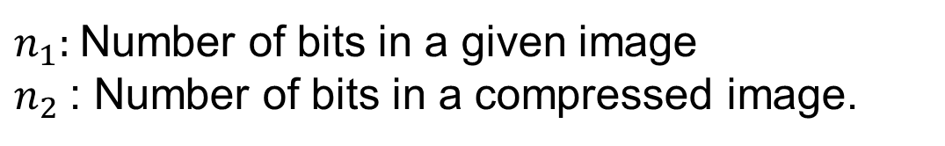
Compression Ratio: Relevant Redundancy:
$n_{1}:$Number of bits in a given image
$n_{2}$: Number of bits in a compressed image​.

Slide 24
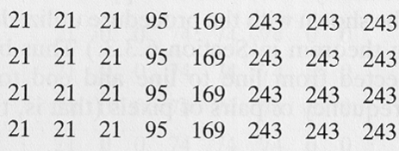

Example: What is the required storage space for this image region?
What is the code length, $l(rk )$?
What is the average code length, $Lav$?
What is the Entropy of this image?
What is redundancy of this image?

Slide 25
Answer without Information Theory:
Required storage space for this image: 4x8x8 bits/pixel =256 bits

Slide 26
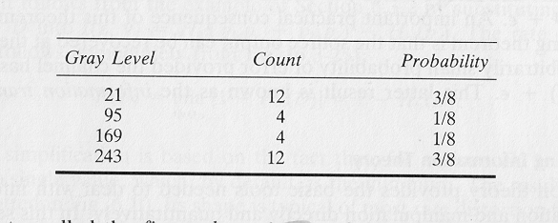
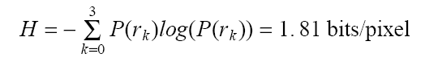
Answer with Information Theory and Estimate the Entropy
What is the redundancy?
R= L_{avg}- H where L_{avg} = 8 bits/pixel
R= 6.19 bits/pixel

Slide 27
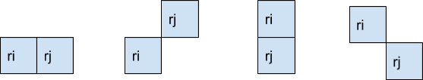
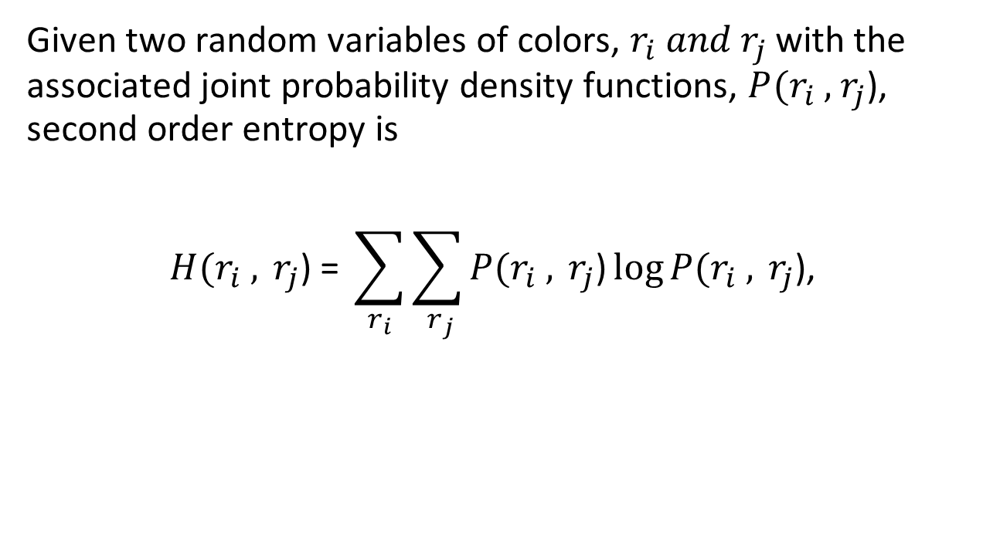
Definition: Second order entropy
Given two random variables of colors, $r_{i} and{ r}_{j}$ with the associated joint probability density functions, $P(r_{i} ,{ r}_{j}$), second order entropy is
$$H(r_{i} ,{ r}_{j}\text{)}\text{ = }\sum_{r_{i}}{\sum_{{ r}_{j}}{P(r_{i} ,{ r}_{j}\text{)}\log{P(r_{i} ,{ r}_{j}\text{),}}}}$$

Slide 28
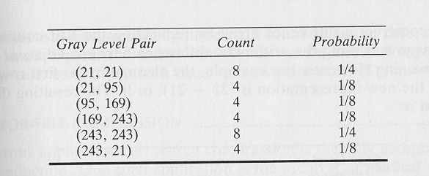

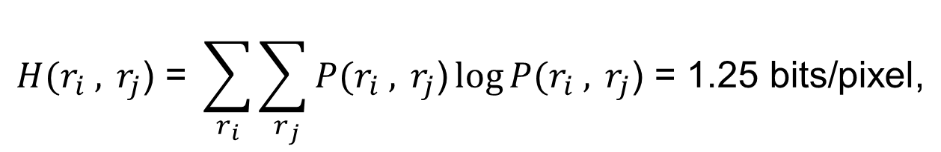
Answer with Second order Entropy
Step 1 : Compute joint relative frequencies $P(r_{i}$ , $r_{j}$ ) of two horizontal neighboring pixels.
Step 2: Compute second order entropy
$$H(r_{i} ,{ r}_{j}\text{) = }\sum_{r_{i}}{\sum_{{ r}_{j}}{P(r_{i} ,{ r}_{j}\text{)}\log{P(r_{i} ,{ r}_{j}\text{)}\text{ = }\text{1}\text{.}\text{25 }\text{bits}\text{/}\text{pixel}\text{,}}}}$$

Slide 29
Image Compression Methods
Reduce redundancy to represent the same amount of information , measured by Entropy
Lossless
Information preserving
Low compression ratios
Lossy
Information loss
High compression ratios
Trade-off: information loss vs. compression ratio

Slide 30
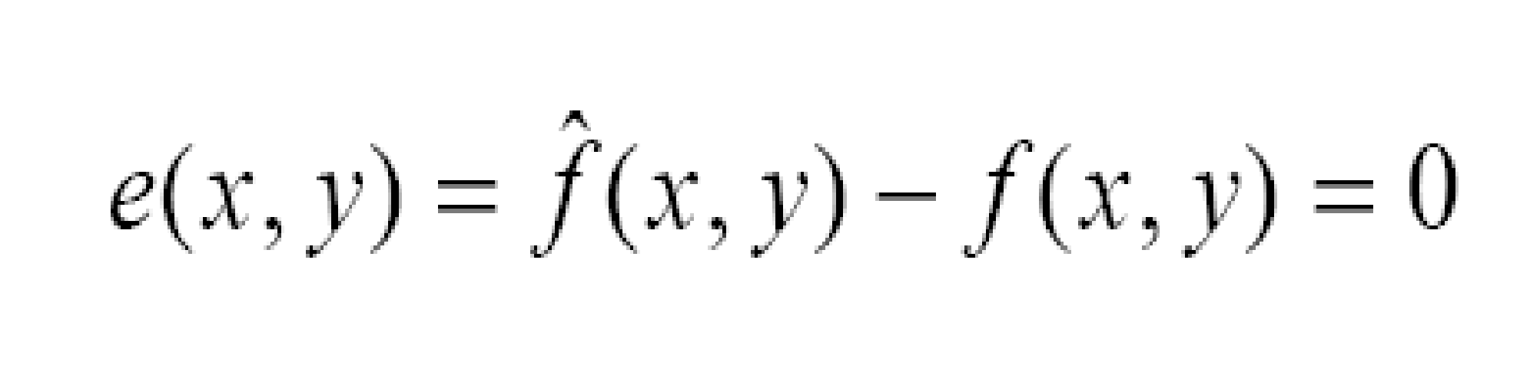

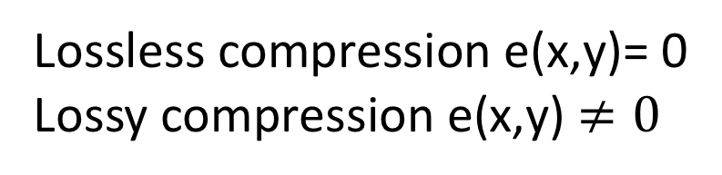
Lossless vs. Lossy Compression
Notes:
30

Slide 31
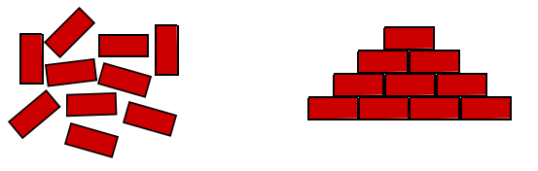
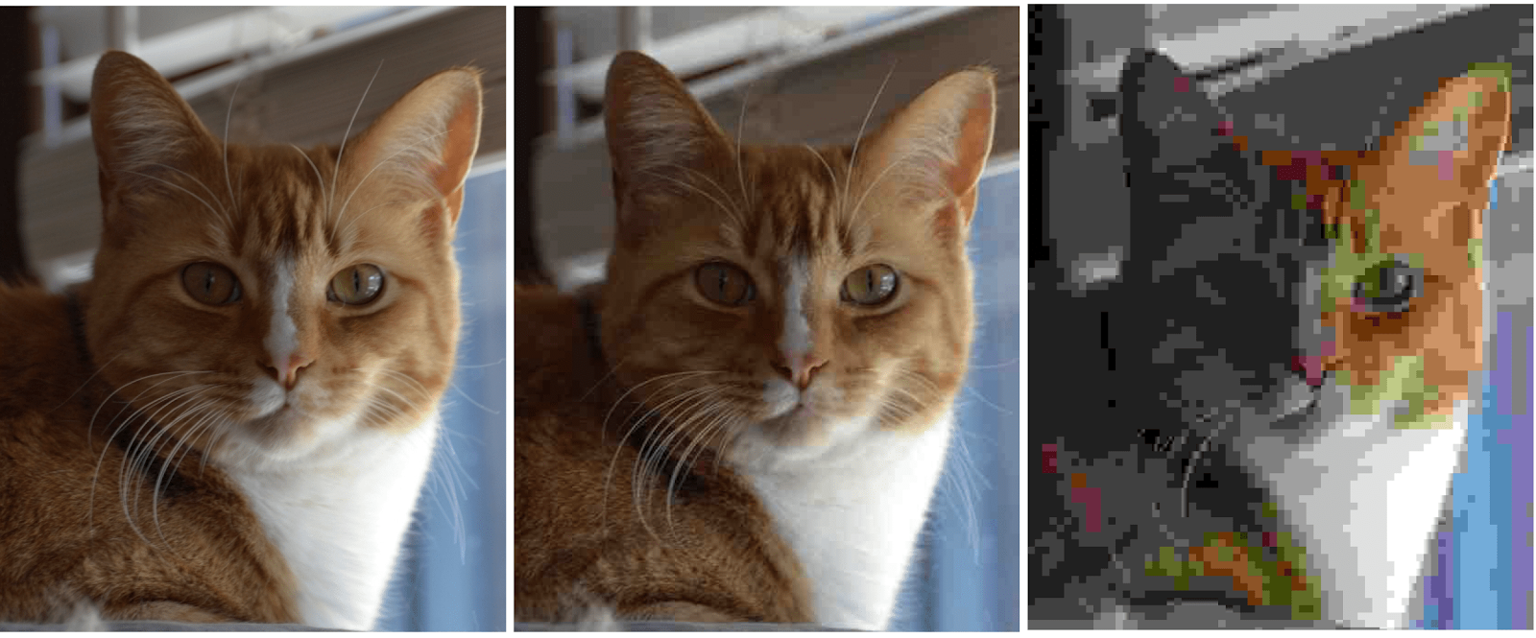
Image Compression Algorithms:
Reduces the redundancies
Interpixel Redundancy: Repetition of the same color, texture or shape (Spatial or temporal)
2. Psychovisual Redundancy: Limitations of HVS
3. Coding Redundancy: Unnecessary bit allocation per pixel

Slide 32
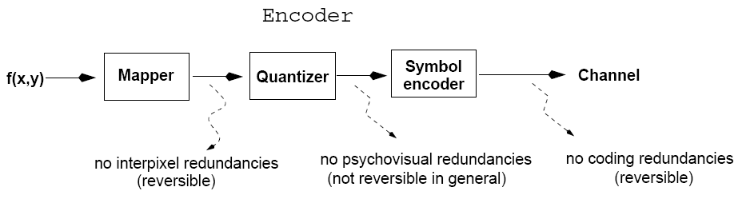
Image Compression Steps
Mapper, reduces interpixel redundancies.
Spatial redundancy, where the same color is repeated in large image patches.
Geometric redundancy, where the same pattern or shape is repeated to form a texture.
Interframe redundancy, where the video frames are repeated from a reference frame.

Slide 33
Image Compression Steps
Quantizer: Quantizes the data to reduce psychovisual redundancies.
Notes:
33

Slide 34
Image Compression Steps
Symbol encoder: encodes the data to reduce coding redundancies.
Notes:
34

Slide 35
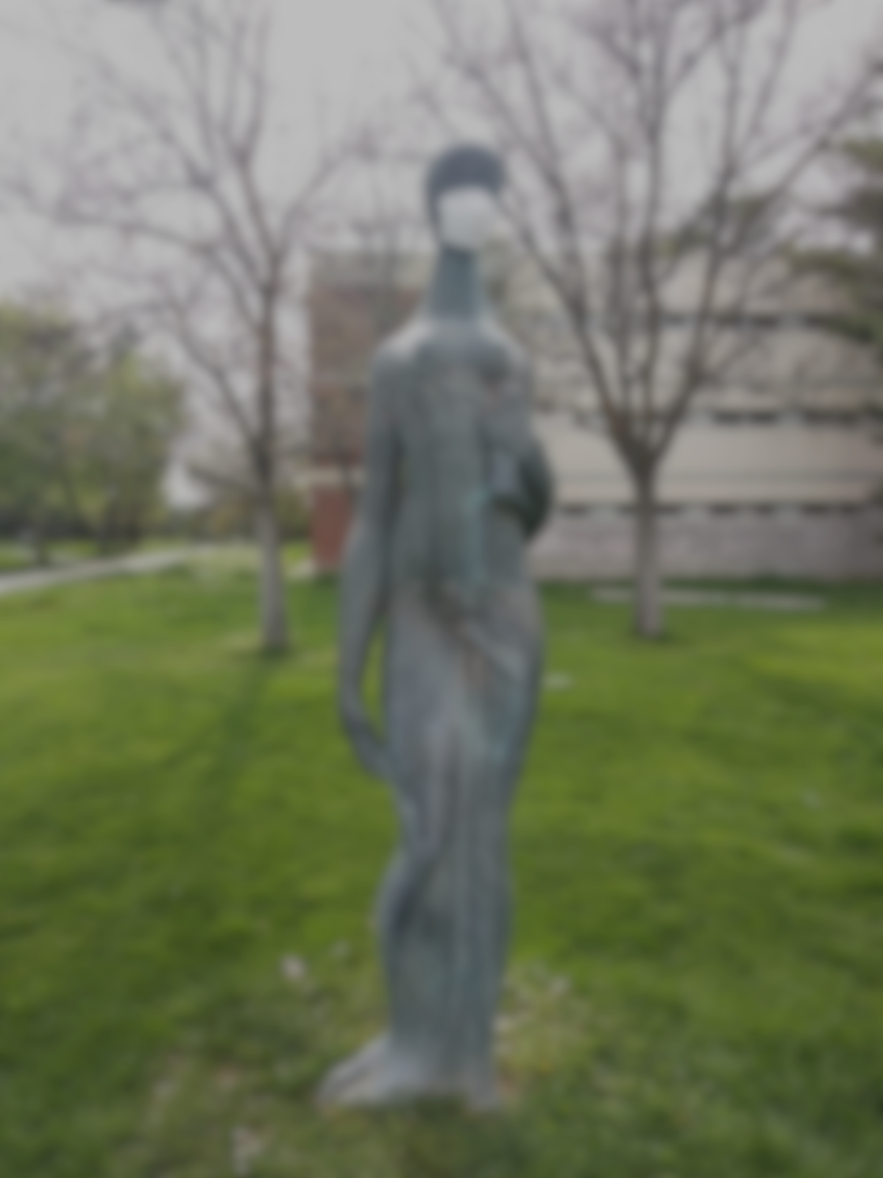
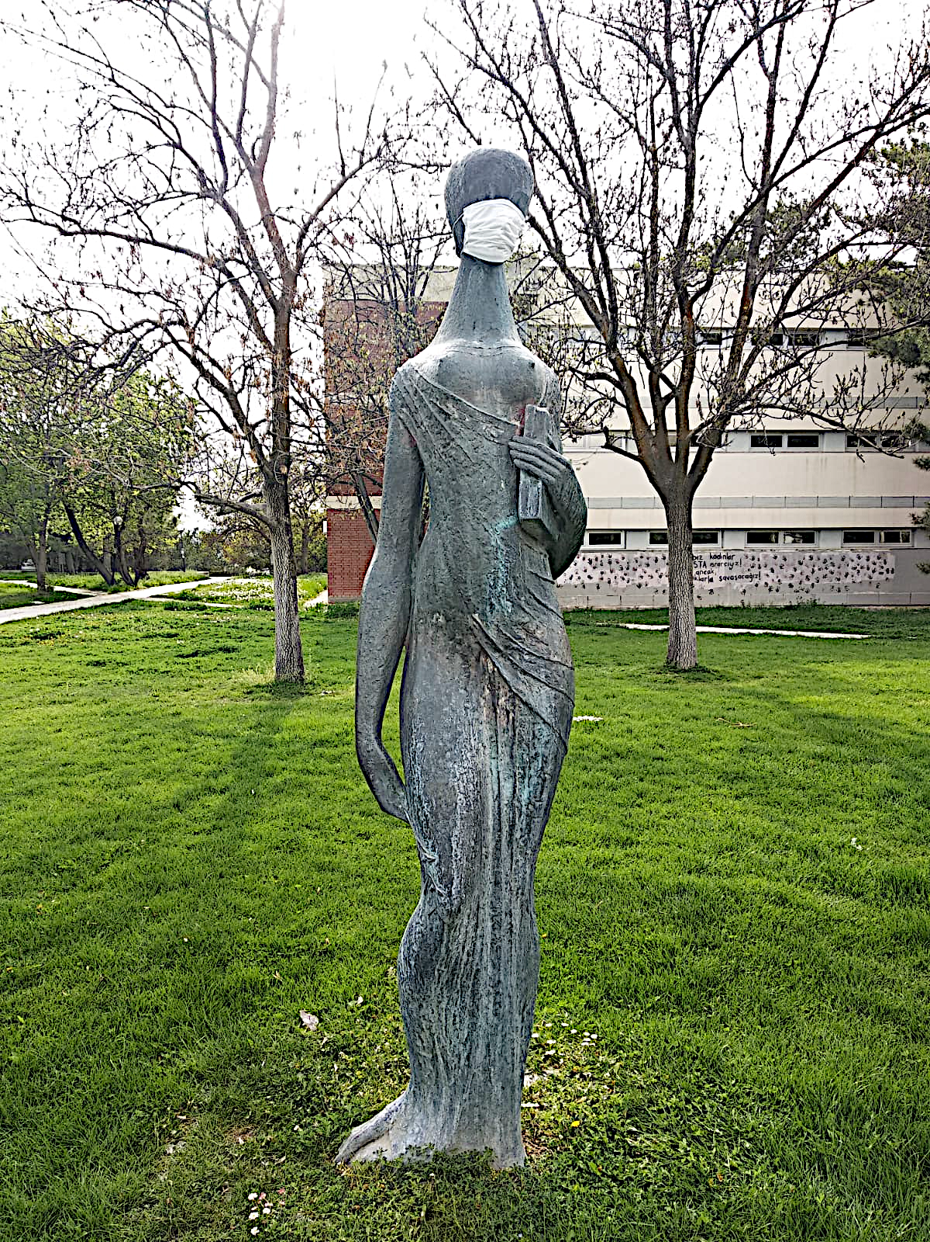
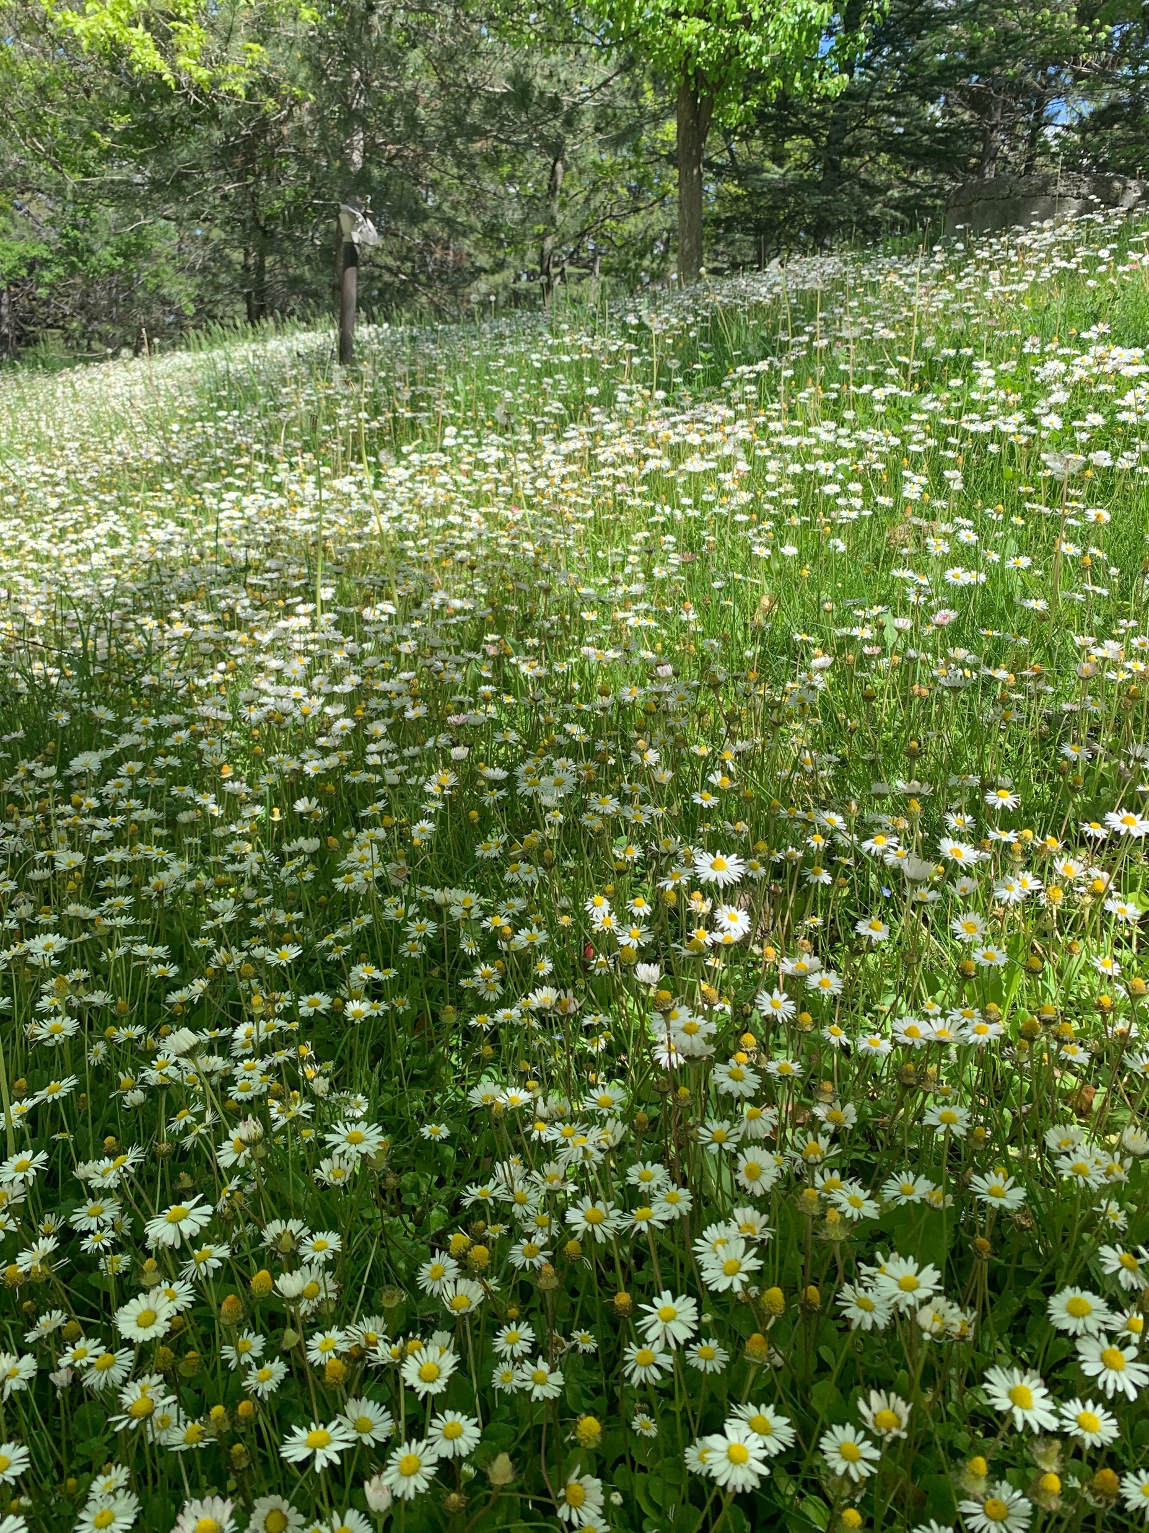
1. Mapper: Reduce Interpixel Redundancy
Image Transforms
Run Length Coding
Bit Plane Slicing and encoding

Slide 36
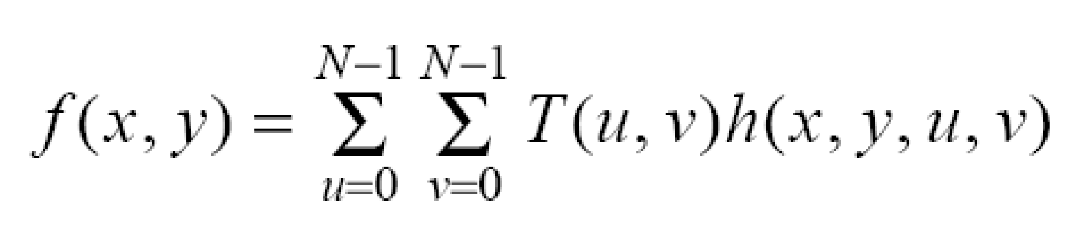
1.1. Mapper: Image Transforms
T(u,v) can be computed using various transformations, for example:
DFT ( Discrete Fourier Transform)
DCT (Discrete Cosine Transform)
DWT (Discrete Wavelet Transform)
JPEG uses DCT for handling interpixel redundancy.

Slide 37

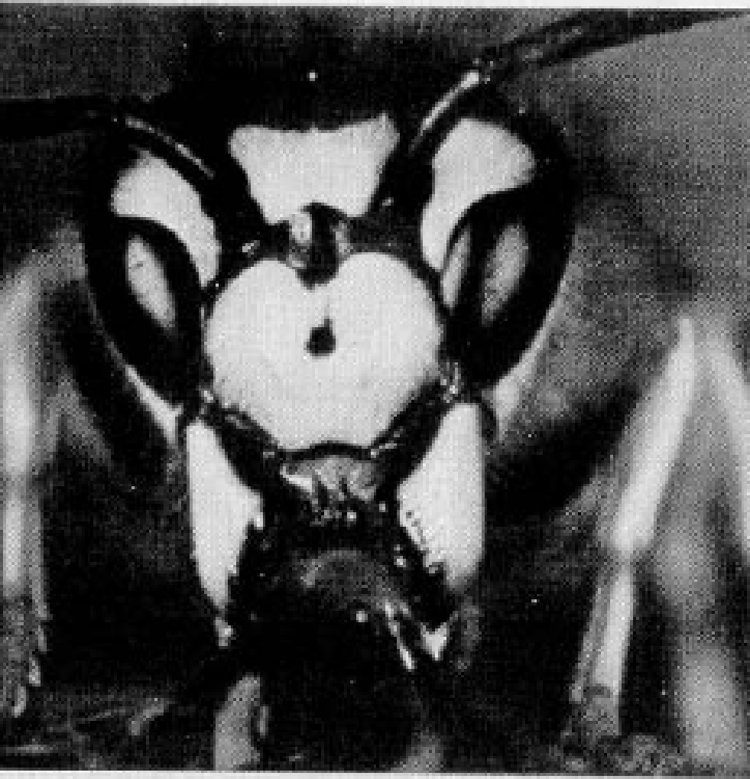
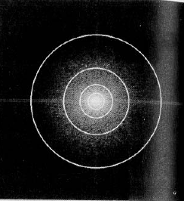

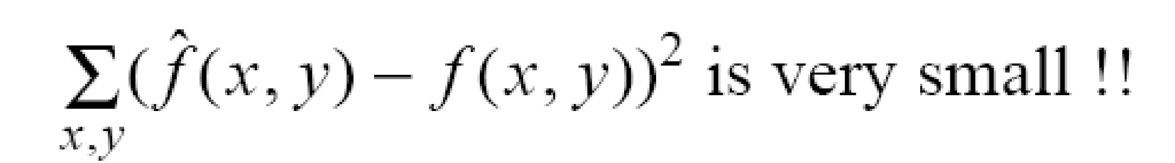
Example: Fourier Transform
Note that the magnitude of the FT decreases, as u, v increase!
K << N
K-1
K-1

Slide 38
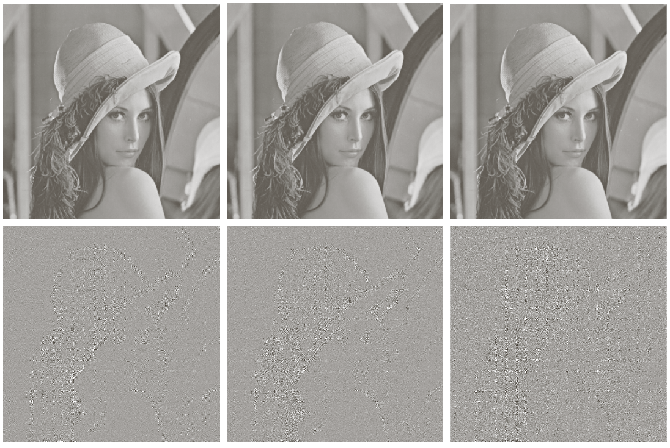

Comparison of DFT, HT and DCT
DFT
Hadamard T
DCT
Using
8 x 8 sub-images
yields 64 coefficients
per sub-image.
Reconstructed images
by truncating
50% of the
coefficients
DCT is a more compact
transformation!
RMS error: 2.32 1.78 1.13

Slide 39
1. 2. Mapper: Run-length coding (RLC)
Reduce the interpixel redundancy of repeating string of symbols (i.e., runs)
1 1 1 1 1 0 0 0 0 0 0 1 ... (1,5) (0, 6) (1, 1)
a a a b b b b b b c c ... (a,3) (b, 6) (c, 2)
Encodes a run of symbols into two bytes: (symbol, count)
Can compress any type of data but cannot achieve high compression ratios compared to other compression methods.
Notes:
39

Slide 40
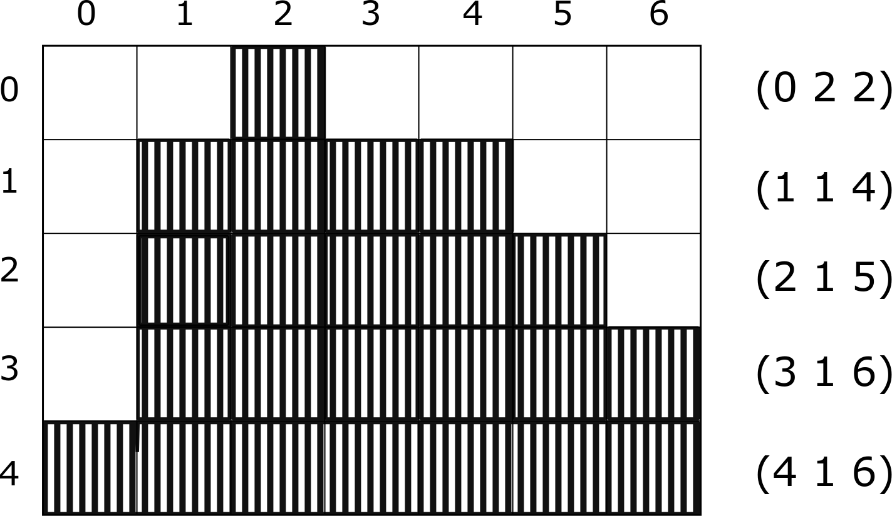
1.2. Run length Coding for Binary Images
Image as a list of lists:
I=(0,​​ 2,​​ 2​​) (1 1 4)(2 1 5)(3 1 6)(4 1 6)

Slide 41
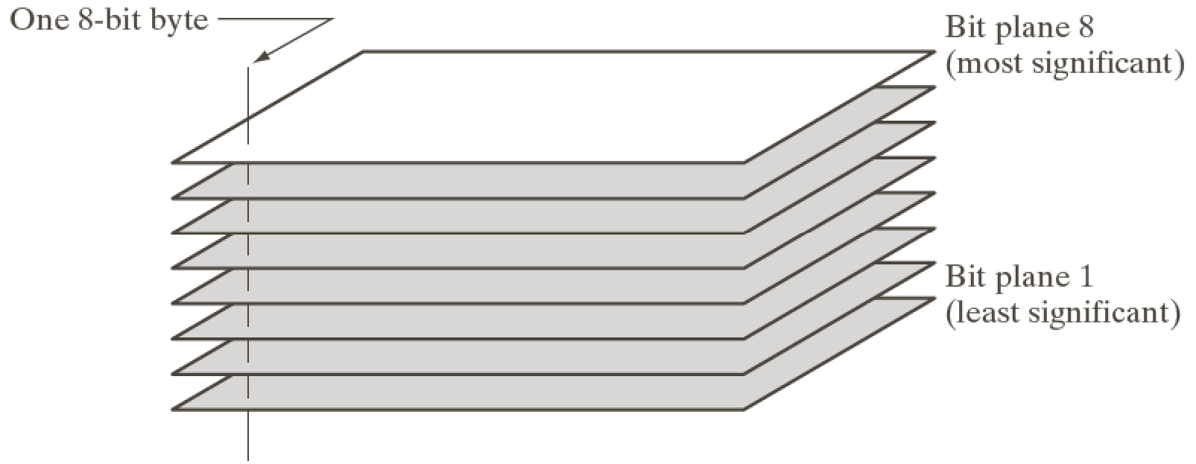
1. 3. Bit-plane coding, reduces interpixel redundancy
Process each bit plane individually.
(1) Decompose an image into a series of binary images.
(2) Compress each binary image (e.g., using run-length coding)

Slide 42

1.3 Bit Plane Slicing: Remove least significant bits

Slide 43
2. Quantizer: Reduce Psychovisual Redundancy
Sampling and Interpolation
Quantization
Vector Quantization
Color Quantization

Slide 44

2.1. Sampling and Interpolation
Down sampled image
Original image
Up sampled and sinc interpolated image

Slide 45


2.2. Vector Quantization
An image is made out of similar patches that we cannot discriminate

Slide 46

A Simple Vector Quantization Method

Slide 47

2.. Color Quantization
Find Color Histogram
Select Colors to represent image
Discard the rest of the colors assigning them to the nrerest selected colors

Slide 48

K- Means Clustering for Color Quantization
Cluster similar colors into K- Groups, in D-Dimensional color space

Slide 49
K-means Algorithm Clustering for Color quantization
Form K-means clusters from a set of n-dimensional vectors
1. Set ic (iteration count) to 1
2. Choose randomly a set of K means m1(1), …, mK(1).
3. For each vector xi, compute E (xi,mk(ic)), k=1,…K
and assign xi to the cluster Cj with nearest mean.
4. Increment ic by 1, update the means to get m1(ic),…,mK(ic).
5. Repeat steps 3 and 4 until Ck(ic) = Ck(ic+1) for all k.
6. Select the colors as cluster mean colors and assign all the colors to the color of the nearest mean.

Slide 50

K- Means Color Quantization

Slide 51

A Fast Color Quantization Algorithm Using a Set of One Dimensional Color Intervals M. Uysal , F.T. Yarman Vural, IEEE-ICIP

Slide 52





Form Color Similarity Matrix (CSM)
For each row of CSM, compute error for color $rk$

Slide 53


3. Symbol Encoder: Reduces Coding Redundancy
Recall the Average Number of bits per pixel is defined as,
r_{k}: k-th gray level
l(r_{k}): # of bits, allocated for coding color r_{k}
p(r_{k}): Probability of r_{k}
Average size of an NxM Image:

Slide 54




Case 1: Code length , $l(rk)$has fixed length
Example:

Slide 55


Case 2 Code length , l(r_{k}) has variable length
Total number of bits: 2.7NM

Slide 56

Huffman Coding
Forward Pass
1. Sort probabilities per symbol
2. Combine the lowest two probabilities
3. Repeat Step2 until only two probabilities remain.

Slide 57

Huffman Coding
Backward Pass
Assign code symbols going backwards

Slide 58



Huffman Coding
L_{avg} assuming binary coding:
$$Entropy:H=−\sum{p\left(a_{k }\right)\log{p\left(a_{k }\right) \sim 2.14 bits/pixel}}$$

Slide 59

Huffman Coding-Decoding
Both coding and decoding can be implemented using a look-up table.
Note that decoding can be done unambiguously.

Slide 60
Image Fidelity Criteria: 1. Subjective: based on human observers 2. Objective: mathematically defined criteria
DFT
Hadamard T
DCT
Using
8 x 8 sub-images
yields 64 coefficients
per sub-image.
Reconstructed images
by truncating
50% of the
coefficients
DCT is a more compact
transformation!
RMS error: 2.32 1.78 1.13

Slide 61

Subjective Fidelity Criteria

Slide 62


Objective Fidelity Criteria
Root mean square error (RMS)
Mean-square signal-to-noise ratio (SNR)
Notes:
62

